Slide 1
Employee Data Analysis using Excel
STUDENT NAME: J . Felicia
REGISTER NO: 312204177
DEPARTMENT: B.com( General )
COLLEGE : C.S.I EWART WOMEN’S CHRISTIAN COLLEGE ,MELROSAPURAM.

Slide 2
PROJECT TITLE
Salary and compensation analysis through excel data modeling

Slide 3


AGENDA
Problem Statement
Project Overview
End Users
Our Solution and Proposition
Dataset Description
Modelling Approach
Results and Discussion
Conclusion
3/21/2024 Annual Review

Slide 4

PROBLEM STATEMENT * How Much Leave The Employee are Taken . * How much dayes the employee are present or absent

Slide 5

PROJECT OVERVIEW
. Implement charts and graphs to visualize performance trends
By the graphs we can easily calculate the salary as well as the compensation of employees .

Slide 6





WHO ARE THE END USERS? 1. ORGANIZATION 2. MANAGER 3. EMPLOYEE AND EMPLOYER 4. HR PROFESSIONALS

Slide 7

OUR SOLUTION AND ITS VALUE PROPOSITION
Conditional formatting – to highlight the missing values Filter - To remove the missing values Formula – To calculate the employee performance pivot – For summary Graph – data visualization

Slide 8
Dataset Description
^{Employee – kaggle} ^{26 – features} ^{9 – features} ^{Emp I’d – num} ^{Emp type} ^{Performance level} ^{Gender – male , female} ^{Emp – Age} ^{Attribution} ^{Employee monthly income} ^{Employee job role} ^{Employee recognition}

Slide 9

THE "WOW" IN OUR SOLUTION
Performance level =IFS(Z8>=5,“VERY HIGH ”,Z8>=4,“HIGH”,Z8>=3,”MED”,TRUE,“LOW”)
3/21/2024 Annual Review
9

Slide 10
MODELING:
Data collection
Download from kaggle
Feature collection
Feature refers to the measure of the impact each input variable (feature) has on the output of a predictive model.
10

Slide 11
Data cleaning
Identifing the missing values
Filter out of missing values
Summary
Pivot table
Job role as x axis
Monthly income by job role as y axis
Visualization
Graph

Slide 12
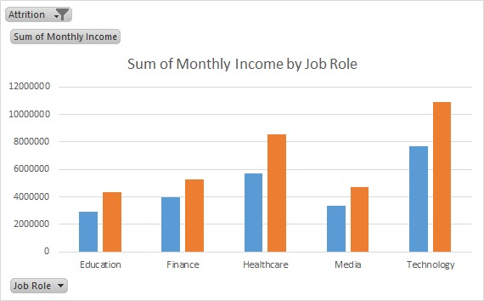
RESULTS
12

Slide 13
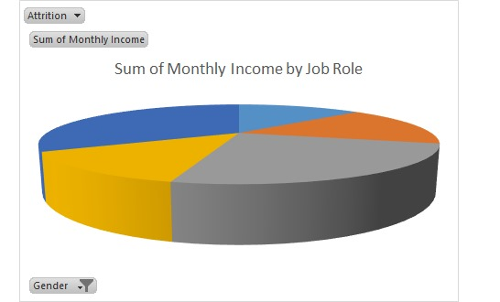
Results

Slide 14
conclusion
•We can give the work regard the employees talent •We have to motivate the Employees •We can increase the salary if the employee did the work perfect

